Slide 1
Project 4: Clustering
Group members:
Han Liu, Serdarcan Dilbaz, Paritosh Goel

Slide 2
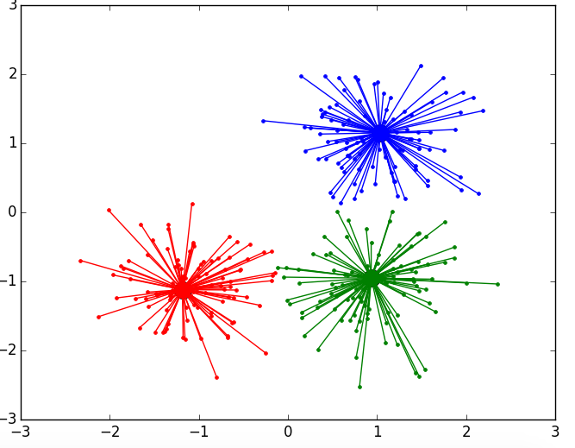
Affinity Propagation
Affinity Propagation
https://plot.ly/scikit-learn/plot-affinity-propagation/

Slide 3
Key Attributes
Does not require raw N x D data matrix
Operates on N x N similarity matrix
Each cluster is represented by an exemplar
Number of clusters determined by the algorithm

Slide 4


Objective Function
The objective function is maximized through max-product loopy belief propagation.

Slide 5
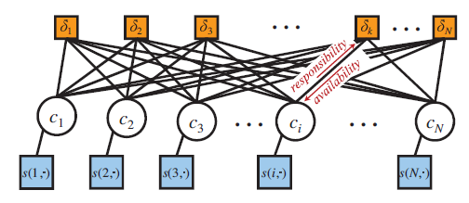
Max-Product Loopy Belief Propagation
Factor Graph for Affinity Propagation
https://www.psi.toronto.edu/affinitypropagation/FreyDueckScience07.pdf

Slide 6
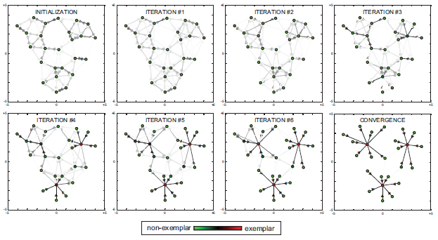
Affinity Propagation Demo

Slide 7
Absenteeism Dataset
Business domain dataset of a courier company
21 Attributes
740 instances
Contains personal, social, and health attributes
No missing values

Slide 8
Guiding questions
What is the natural number of clusters in the data when the dataset is clustered according to health factors (age, social drinker, social smoker, weight, height, BMI)?
What is the natural number of clusters in the data when the dataset is clustered according to social attributes (education, son, social drinker, social smoker, pet)?
What is the natural number of clusters in the data when the dataset is clustered according to work performance (service time, work load average/day, hit target, disciplinary failure and maybe education)?

Slide 9
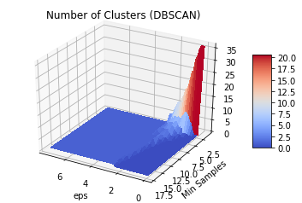
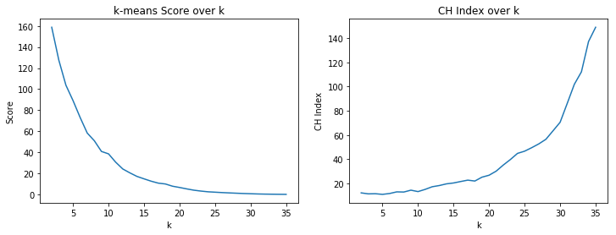
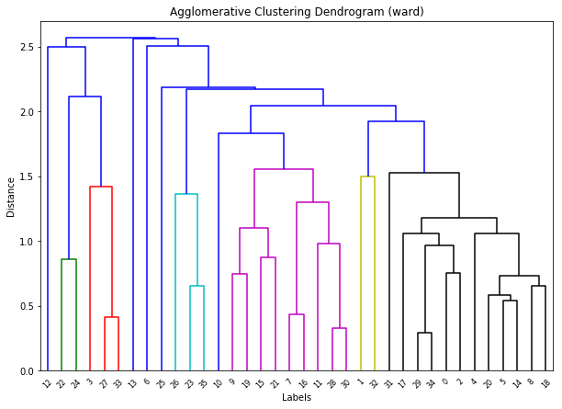
Question 1: Clusters of health factors
Result: There is no natural clustering in the health data

Slide 10
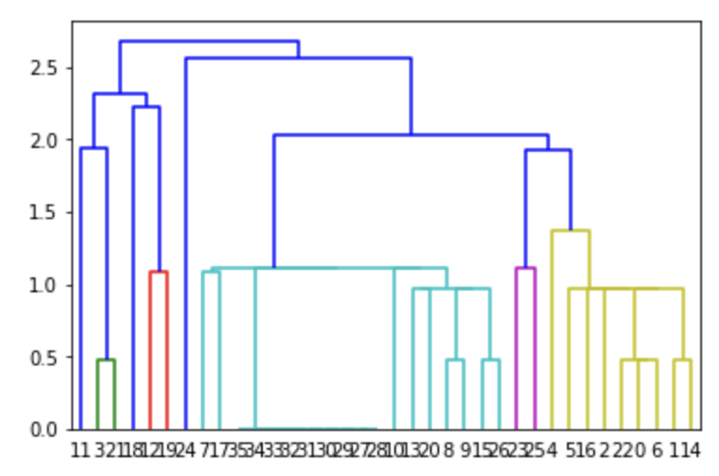
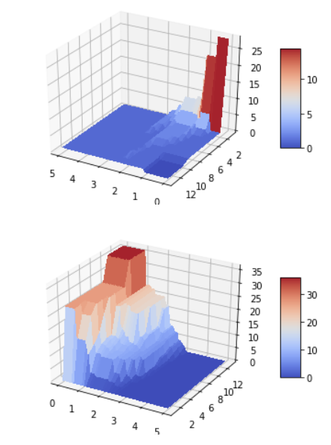
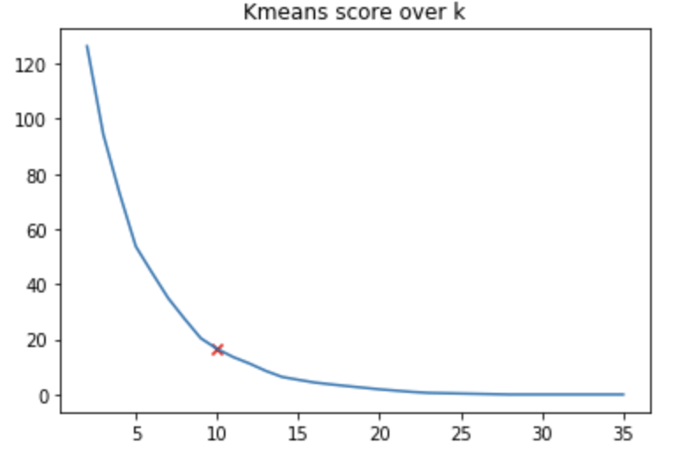
Question 2: Clusters of social factors
social attributes: education, children, social drinker, social smoker, pet
K-means: k=10
DBSCAN: eplison = 1, mini samples = 10

Slide 11
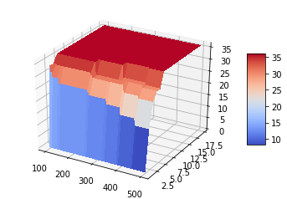
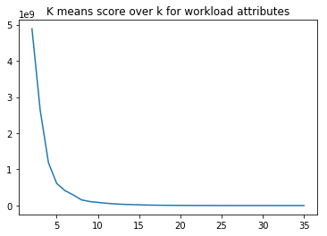
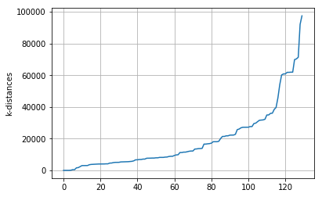
Question 3: Clusters of work performance
work performance: service time,
work load average/day,
hit target,
disciplinary failure

